Slide 1
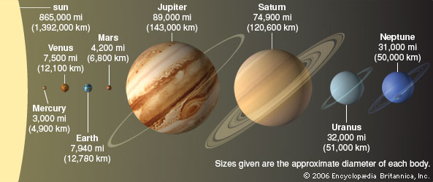
What are the outer planets
Jupiter, Saturn, Uranus, and Neptune
What do they have in common?

Slide 2
Compare and contrast inner and outer planets
Have layers
Orbit the sun
Four of each
No clearly defined surfaces
Only see the atmospheres
Much larger
Have rings
Have moons
Similarities
Difference

Slide 3
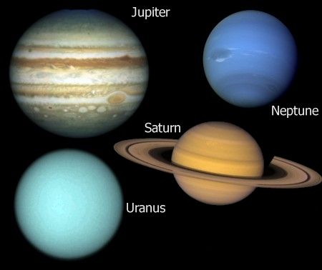
The Outer Planets

Slide 4
Questions
A friend says that a person canNOT walk on the surface of Saturn. Is she right? Explain
Yes, she is right. As an outer planet, Saturn has a gas surface unlike the rocky surface of the inner planets, like Earth.
What effect does gravity have on the outer planets?
Gravity keeps them in motion around the sun.

Slide 5
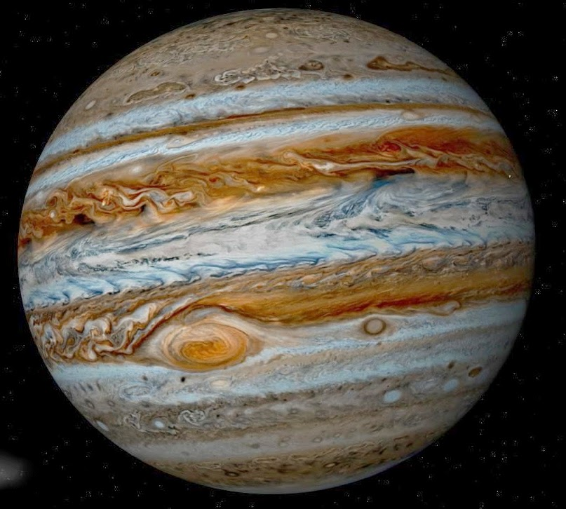
Jupiter
http://www.youtube.com/watch?v=s56pxa9lpvo

Slide 6
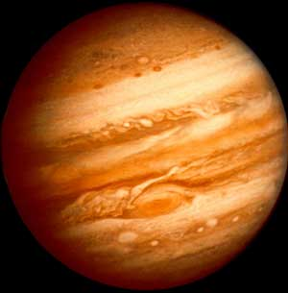
Jupiter
5th planet from the sun
Largest in the solar system
Made of hydrogen and helium that move in bands of color
Fast Rotation
Over 60 moons!

Slide 7
Questions
How many rotations does Jupiter make in 50 Earth days?
50 X 2 Jupiter rotations = 100 Jupiter rotations
What are the main gases that make up Jupiter’s atmosphere?
Hydrogen and helium
Would the length of a day on Jupiter be longer or shorter than a day on Earth?
Shorter

Slide 8
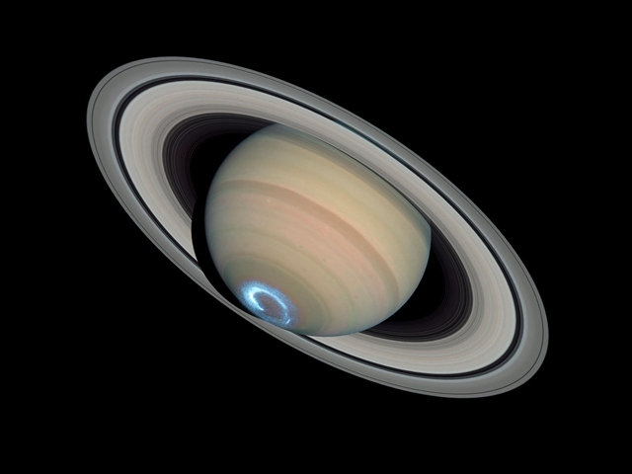
Saturn
https://www.youtube.com/watch?v=MS9D9CzwPQU

Slide 9
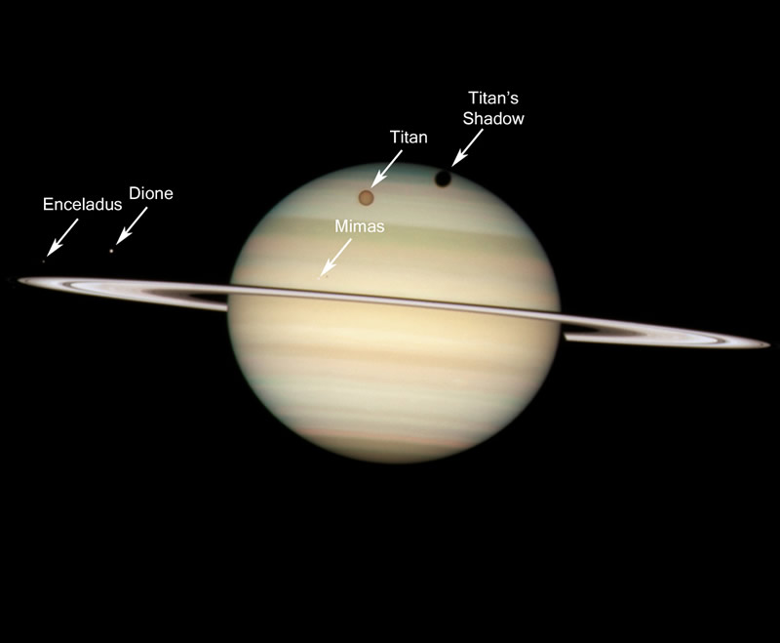
Saturn
6th planet from the sun
Atmosphere contains mostly hydrogen and helium
Low density
Best rings!
Inner rings rotate faster than outer rings
Over 62 moons

Slide 10
Questions
How are Saturn and Jupiter alike and different?
Both are gas giants and have atmospheres made up of hydrogen and helium. Jupiter is larger than Saturn. Also, Saturn has more visible rings.
What keeps Saturn’s rings in orbit?
Gravity!

Slide 11
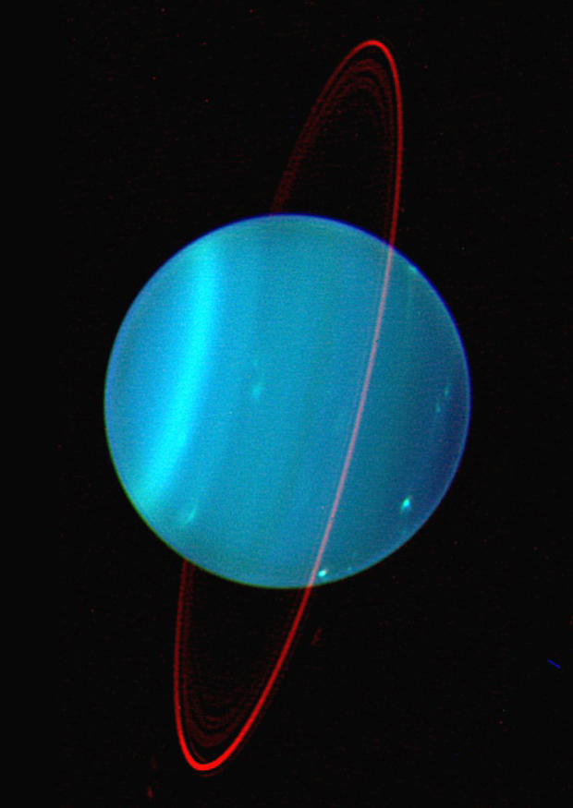
Uranus
http://www.youtube.com/watch?v=G7f1nuwRq_E

Slide 12
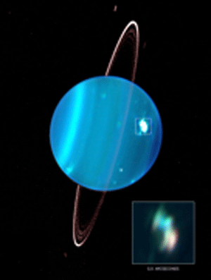
Uranus
7th planet from the sun
Hydrogen, helium, and methane
“fuzzy blue-green”
Rotates on its side
And we don’t know why!
27 moons
Rings
Space diamonds!

Slide 13
Questions
What gases make up Uranus’s atmosphere?
Hydrogen, helium, and methane
In what direction does the equator on Uranus run?
North to South

Slide 14
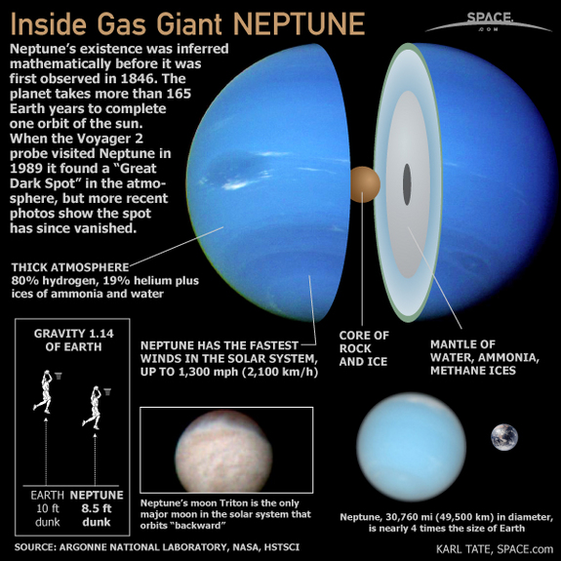
Neptune

Slide 15
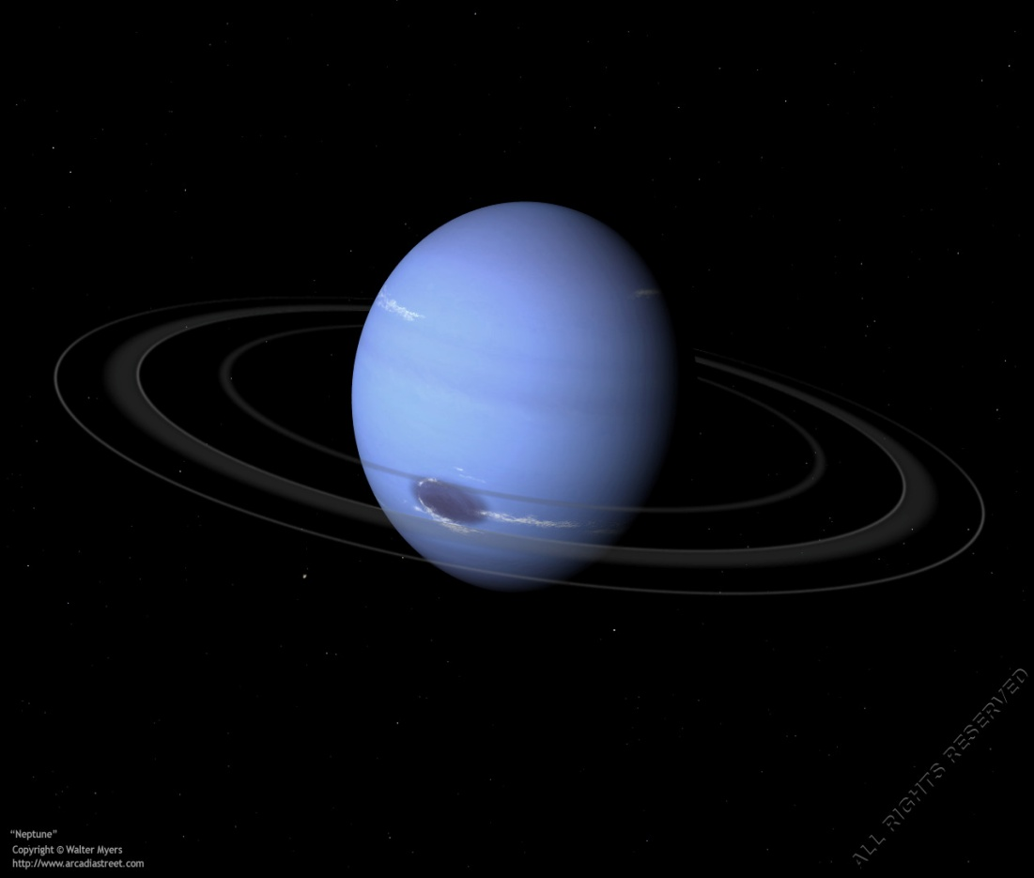
Neptune
8th planet from the sun
Too far to see
13 moons
Bluish color
Storms
Bands of clouds
http://www.youtube.com/watch?v=EmUvTH7sveg

Slide 16
Questions
What effect do you think Neptune’s distance from Earth has on its temperature?
Neptune’s temperature is very cold because it is so far from the sun.
What gases make up Uranus’s atmosphere?
Hydrogen, Helium, and Methane
What record does Neptune’s moon, Triton, hold?
Triton might be the coldest body in the solar system.

Slide 17
http://www.kidsastronomy.com/saturn.htm
http://www.youtube.com/watch?v=MS9D9CzwPQU

