Slide 1
The End of Rome
What lead to the end of one of the greatest civilizations in human history?
http://www.brainpop.com/socialstudies/worldhistory/falloftheromanempire/

Slide 2
Bad Leadership | Military Defeats | Economic Problems

Slide 3
Bad Leadership | Military Defeats | Economic Problems
Single all powerful rulers making mistakes | Soldiers fought each other when military generals were competing for power | Emperors bribed soldiers for loyalty, using Rome’s money
Only one person had power and they didn’t always make good choices | Left big gaps on Rome’s boarders. Invaders!!! | Made more money, causing all money to have less value
It was difficult to fix previous ruler’s mistakes |  | Emperors liked to party! And used tax money to pay for luxuries
No system for choosing new emperors, so they kept killing each other |  | Lead to food shortages
 |  | Unemployment

Slide 4
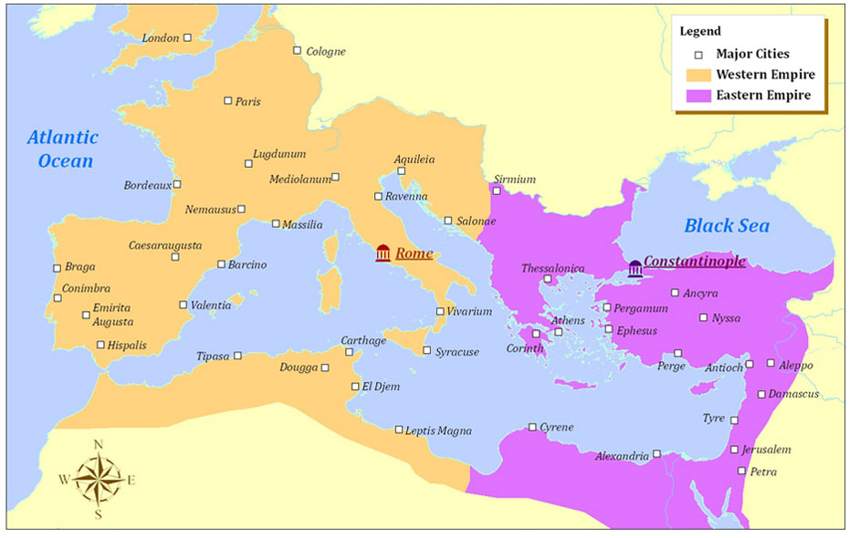
Diocletian makes the split

Slide 5
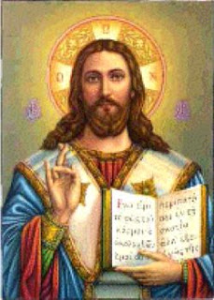
Constantine makes a new capital on the East
Now known as the Byzantine Empire
Hello Constantinople
First Christian emperor
Would last for another 1000 years! Hooray!

Slide 6
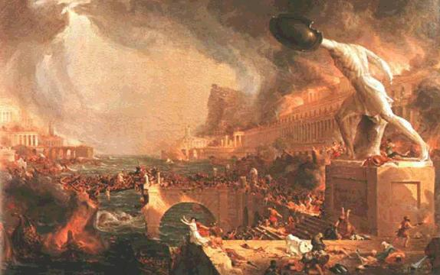
Goodbye Rome! (Western)
Too many problems
Invaders take over
The Roman empire is no more

