Slide 1
Ancient Greece
Lesson 1
The Geography of Ancient Greece and the Development of City-states

Slide 2
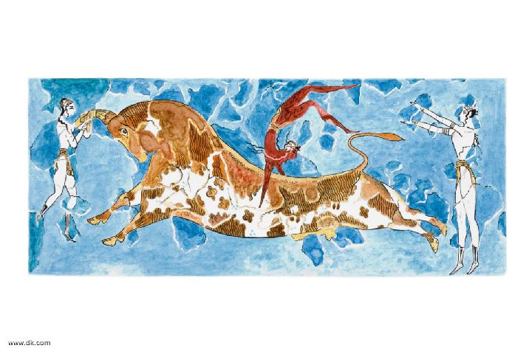
Early Greeks and the Rise of City-States

Slide 3
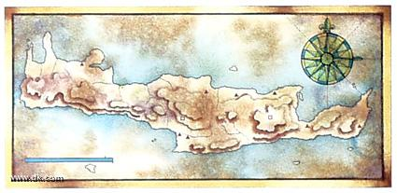
The Minoans
The Mycenaeans
First civilization of Aegean World 6000 B.C.-1400 B.C.
Island of Crete
Ruled by King Minos
Sailors and Traders
Invented early form of writing called linear B writing
Destroyed by a volcano, tidal wave
Conquered by Mycenaeans
1600 B.C.-1200 B.C.
Controlled mainland of Greece
Ruled by King Agamemnon
Warring people, built fort-like cities
Kept records in linear B
Fell to foreign invaders 1200 B.C.

Slide 4
In what ways did the Minoans and Mycenaeans influence Greek civilization?
The Minoans built great palaces with colorful frescoes and developed a system of writing called linear B. The Mycenaeans conquered the Minoans and adopted the linear B system to keep records of ancient life for future generations.

Slide 5
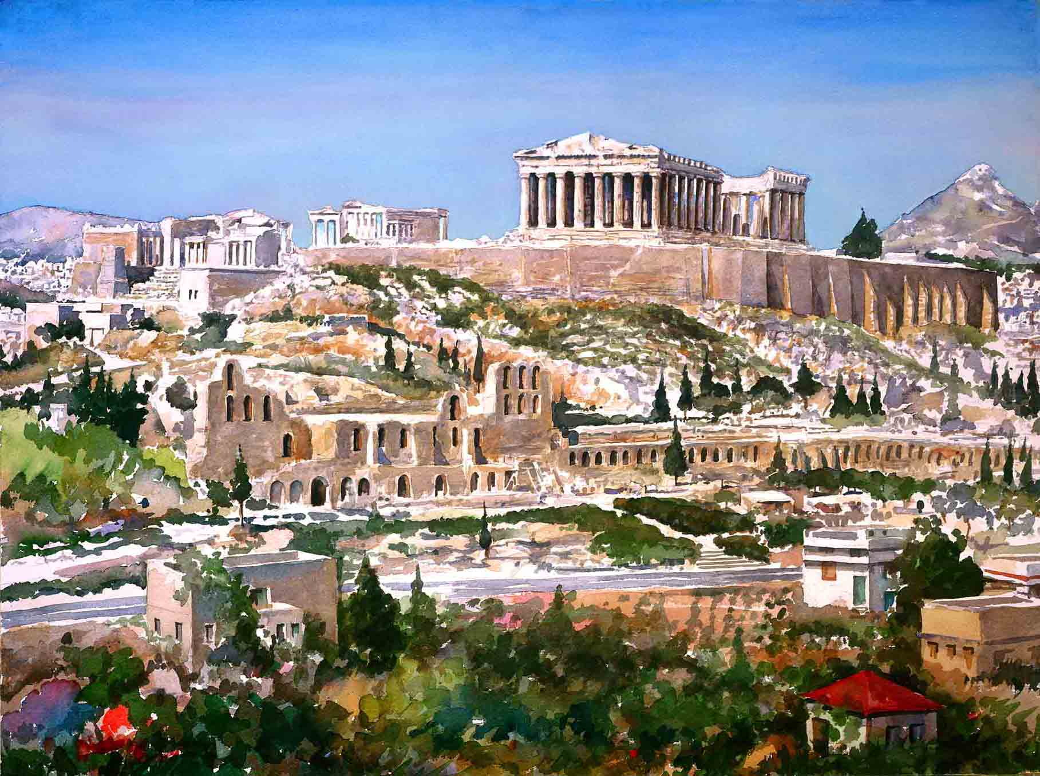
The City-States of Greece
City-State or Polis – a city with its own government that was both a city and an independent small community.
Absolutely independent and self-sufficient community
Includes:
Fort
City
Surrounding lands and small farms

Slide 6
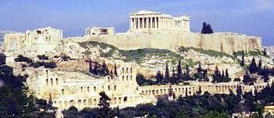
City-State = Center of Greek Identity
Based on 3 Ideas
Geographical territory
Community
Political and economic independence
http://www.youtube.com/watch?v=ZyBm5B-dGEg

Slide 7
In what ways were the Greek city-states alike and different?
Alike | Different

Slide 8
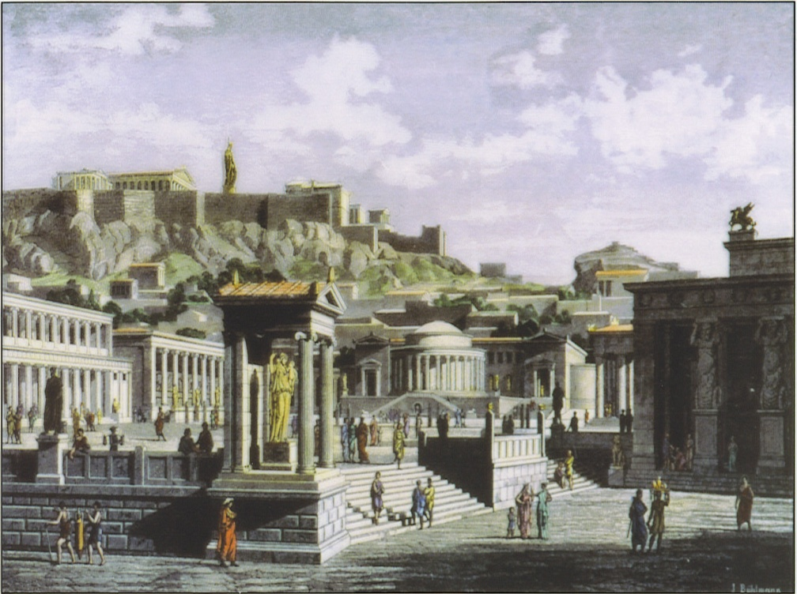
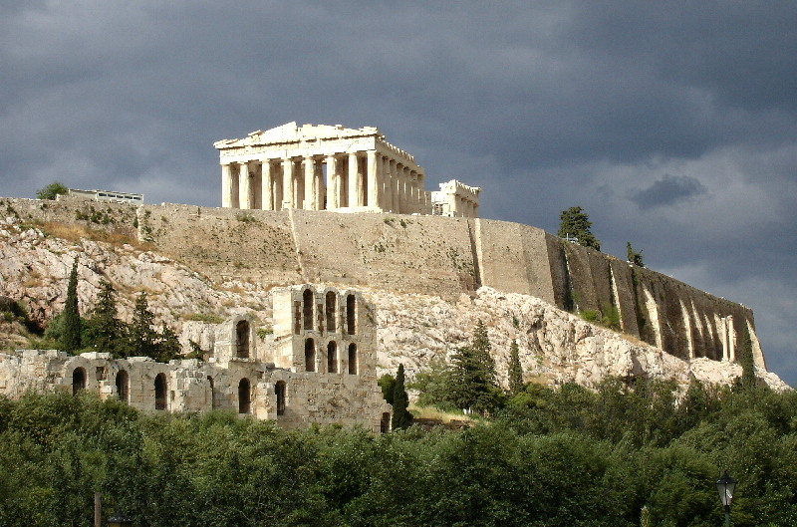
Agora – a central spot in ancient Greek city-states. The literal meaning of the word is "gathering place" or "assembly". The agora was the center of athletic, artistic, spiritual and political life of the city.
Acropolis - center of each city-state, citadel or fortified part of an ancient Greek city, typically built on a hill
Agora
Acropolis

Slide 9
Why was the development of the polis important in ancient Greece?
The whole area of the polis was an individual unit with self-rule. Unlike the Mycenaean cities of Greek's past, where the powerless poor answered to the king, every citizen was at least equal under the law. Citizenship was limited to natives, and only male adult citizens could exercise the vote, but power was distributed more widely than in any previous political system.
The Polis was more than just a place to live & work. It was a place to promote the full moral spiritual & intellectual growth. The body of citizens came to be the most important meaning of the term polis in ancient Greece. The polis was the center of Greek identity.
A polis was a community of citizens in which all political, economic, social, cultural, and religious activities were focused. A polis was an absolutely independent and self-sufficient community. The unity of citizens was important and often meant that city-states would take an active role in directing the patterns of life. One result of this unity was that citizens of one polis would greatly distrust the citizens of a different polis. This distrust kept Greece divided into strongly individual city-states.

Slide 10
Greek Names
The Greek alphabet letters look somewhat like the English alphabet. Greek alphabet letter names are familiar and still used today. The names of college fraternities and sororities are Greek letters. The saying “from alpha to omega,” meaning, “from beginning to end,” is well known.
Ancient Greeks did NOT invent the alphabet
They adopted a set of signs used in Syria and modified them to form a simple alphabet of 24 letters

Slide 11
Spelling Names Phonetically
For example:
The name Robert sounds like Rah-burt
R=rho ah=omega t=tau
There is no “b” and “ur” in the Greek alphabet, so you might use beta, which has a “v” sound, and rho again for “ur.”
http://library.thinkquest.org/17709/language/alphabet.htm

Slide 12
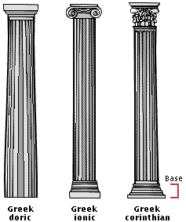
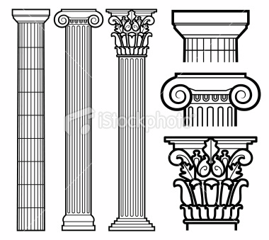
Ionic
Ionic shafts were taller than Doric ones. This makes the columns look slender. They also had flutes, which are lines carved into them from top to bottom. The bases were large and looked like a set of stacked rings. Ionic capitals consist of a scrolls above the shaft. The Ionic style is a little more decorative than the Doric.
Corinthian
The Corinthian order is the most decorative and is usually the one most modern people like best. The Corinthian capitals have flowers and leaves below a small scroll.
Doric
Of the three columns found in Greece, Doric columns are the simplest. They have a capital (the top, or crown) made of a circle topped by a square. The shaft (the tall part of the column) is plain and has 20 sides. There is no base in the Doric order. The Doric order is very plain, but powerful-looking in its design. The area above the column, called the frieze[pronounced "freeze"], had simple patterns. Above the columns are the metopes and triglyphs.

Slide 13
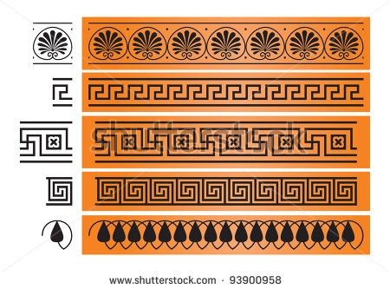
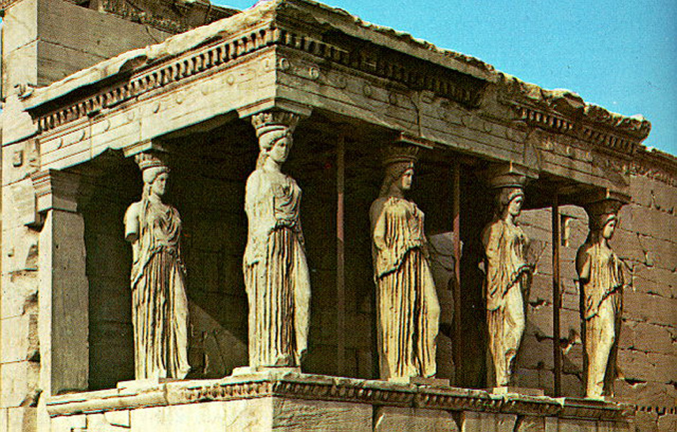
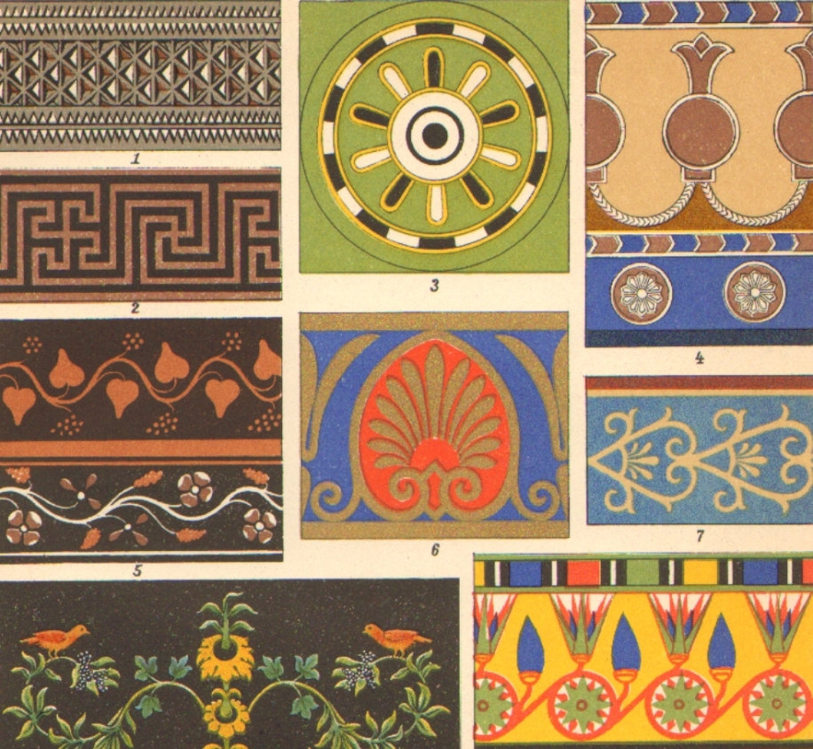
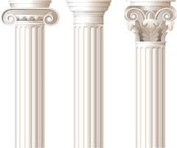
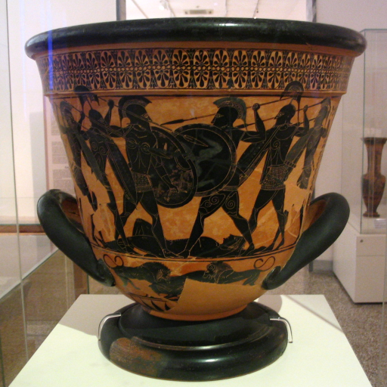
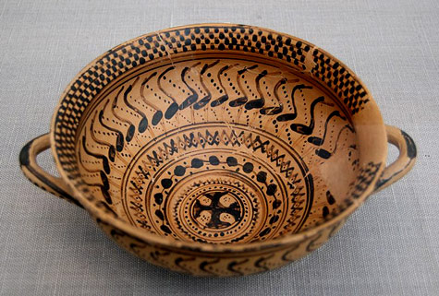

Slide 14
Extra Resources
https://www.youtube.com/watch?v=5FVpL4ma8nQ
http://www.typegreek.com/

