Slide 1
Protestant Reformation and Martin Luther

Slide 2
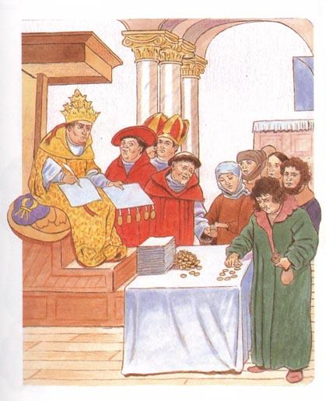
Corruption in the Church! Oh No!
Give us 10 coins and all will be forgiven.
In order to raise money, the Roman Catholic Church promised to grant forgiveness for people's sins if they donated money.
This practice was called selling "indulgences”.
I stole from my neighbor.

Slide 3
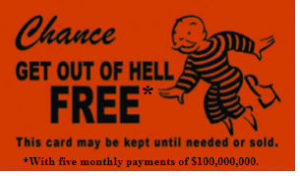
Discussion Question: Do you think selling indulgences is a good way for the church to raise money? Why or why not?

Slide 4
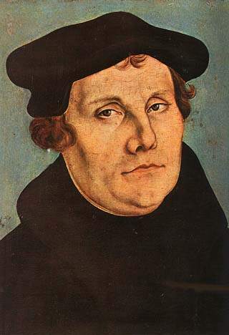
“Oh no they didn’t!” –Martin Luther (Not Really)
Don’t trust the Pope! Talk to God yourself.
Martin Luther began to criticize the Roman Catholic Church for holding too much money and power in Europe, and for selling indulgences.
Martin Luther challenged the authority of the Pope and said that the Bible was the only true authority on faith.

Slide 5
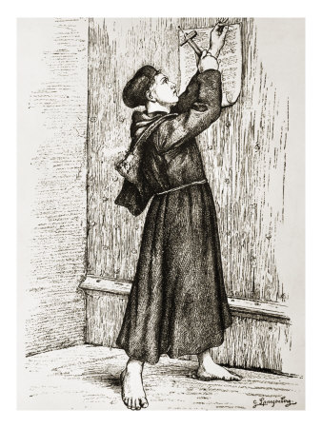
Ninety-five Theses
Martin Luther nailed a list of his criticisms on the door of the Church. This document is called the "95 Theses".

Slide 6
The Protestant Reformation
Martin Luther's criticism launched a movement to reform, or change, the Church in the 16th Century. This movement is known as the Protestant Reformation.
CHANGE God will appreciate!
Reform the Church today!
Protestant Reformation: Changing the Church for the glory of God

Slide 7
Impact of the Reformation
As a result of the Reformation, Western Christianity split into two branches: Protestantism and Roman Catholicism. Many parts of Europe became Protestant and reforms were brought to the Catholic Church.
Western Christianity
Roman Catholicism
Protestantism

Slide 8
Who would say these things: Protestants or Catholics?
“The Pope is the head of the Church.”
“The Bible is the only true authority on faith.”
“The Church can pay for its buildings with money from Indulgences. “
“The Church has become corrupt, or unfair. It has taken power and money.”
“The Church is wrong to sell indulgences.”
“People must communicate with God through a priest. “

Slide 9
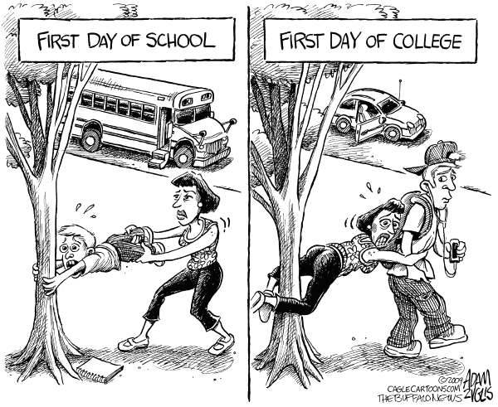
What is a political cartoon?

Slide 10
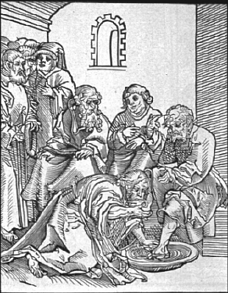
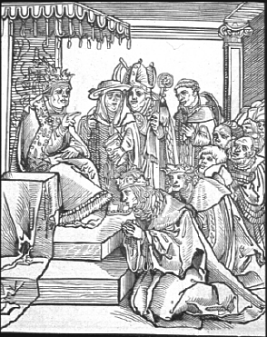
Martin Luther’s Political Cartoon 1: What was Luther’s message?
Jesus washes the feet of his disciples.
The Pope makes others kiss his feet.

Slide 11
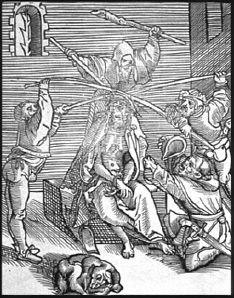
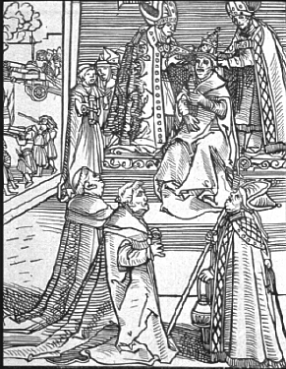
Martin Luther’s Political Cartoon 2: What was Luther’s message?
A crown of thorns is prepared for Christ.
The Pope wears three crowns of gold.

