Slide 1
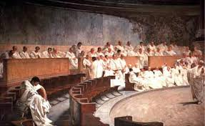
BELL WORK
If you were there…
Imagine that you are a Roman senator. You are worried about the growing power of military men in Rome’s government. Some senators want to take violent action to stop generals from taking power in the senate. They fear the generals will one day become powerful dictators. Is using violence against generals okay if it means saving the Roman Republic?
Write 3-5 sentences explaining your thoughts.
Revised scenario from HOLT World History textbook p. 322

Slide 2
OBJECTIVE
I can analyze the growth and significance of the Roman Empire.

Slide 3
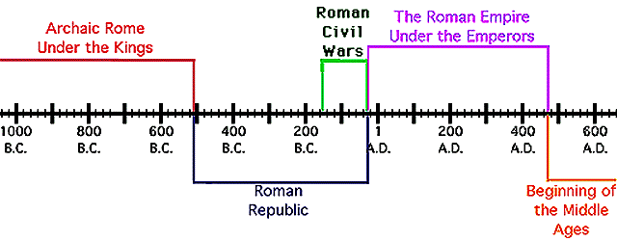
THE ROMAN EMPIRE
The end of the Roman Republic led to the start of the Roman Empire
Today we will see how the Roman turned their republic into an Empire.

Slide 4
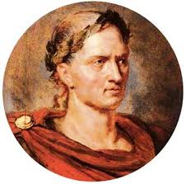
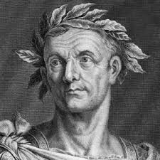
Julius Caesar
Julius Caesar was one of Rome’s most powerful generals
Roman’s admired him for his bravery in battle and land acquisitions
Caesar’s military made him an important figure in Roman politics
Caesar was also an excellent speaker which won him many supporters
In 45 BC, Julius Caesar proclaimed himself the dictator of Rome
Many of the Roman senators did not approve of the way Caesar came to power
On March 15, 44 BC a group of senators attacked Caesar in the senate and killed him

Slide 5
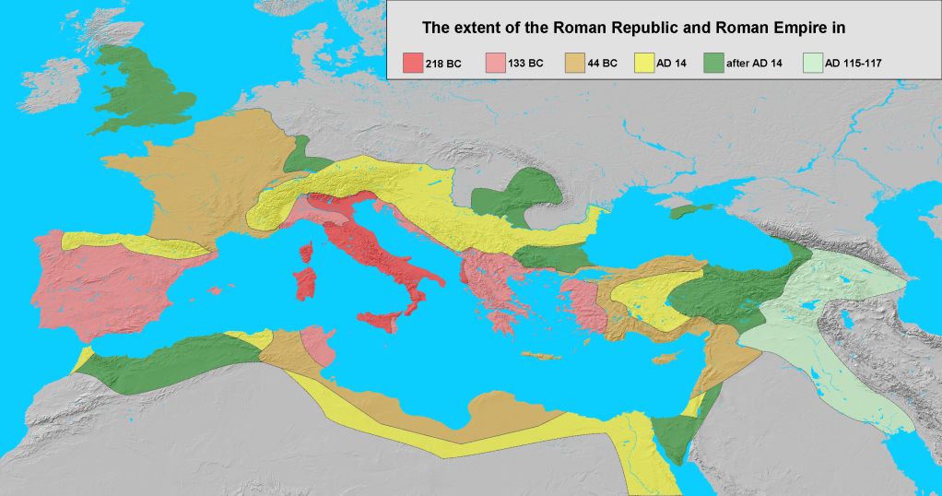
Roman Expansion
Based on the map above, what conclusions can you make about Roman power in 117 AD?

Slide 6
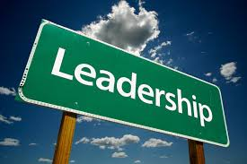
Roman Leadership
What does it take to be the
leader of the Roman Empire?
Keep these facts in mind:
The Romans had over 55,000 miles of paved highways
56 million people lived within the borders of the Roman Empire
The Roman Empire consists of a multitude of people groups with unique cultures, religions, and languages.

Slide 7
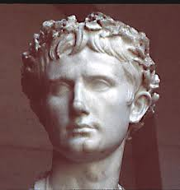
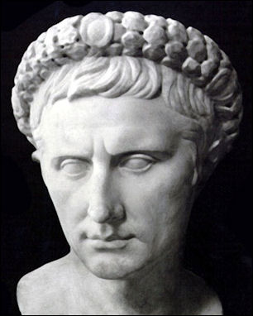
Octavian
Caesar’s adopted son Octavian would become emperor of Rome
In 27 BC, Octavian gave up his senate seat and was named “Augustus” which means “revered one”
With Augustus as the new leader, Rome would enter a new era known as the Roman Empire
The first 200 years of the Roman Empire were very peaceful.
We call this time period the Pax Romana which means Roman Peace

Slide 8
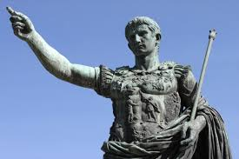
Emperor Augustus
When did he live? 63 BC to 14 AD
Where did he live? Rome
What did he do? As the leader of Rome, Augustus made many improvements in the city. He created a fire department and a police force to protect the city’s people. He built new aqueducts and repaired old ones to increase Rome’s water supply. Augustus also worked on improving and expanding Rome’s road network.
Why is he important? As Rome’s first emperor, Augustus is one of the most significant figures in Roman history. Also singlehandedly, he changed the nature of Roman government forever. But Augustus is also known for the great monuments he build all around Rome. He built a new forum that held statues, monuments, and a great temple to the god Mars. In writing about his life, Augustus declared, “I found Rome a city of brick and left it a city of marble.”
Point of View: Why do you think so many Romans admired Augustus?

Slide 9
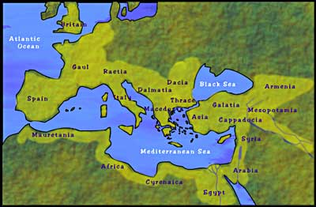
The map above shows the Roman Empire in 117 AD at the height of the Pax Romana. This 200-year period saw unprecedented peace and economic prosperity throughout the Empire, which spanned from England in the north to Morocco in the south and Iraq in the east.
During the Pax Romana, the Roman Empire reached its peak in terms of land area, and its population swelled to an estimated 70 million people.
Source: ushistory.org

Slide 10
Create A Play
With your assigned group, create a short play that reflects what you learned today about Julius Caesar and his son Octavian (later called Augustus).
Your play should be from 1 to 2 minutes long and reflect your knowledge of today’s lesson.

