Slide 1
Chapter One Lesson 2 How do Scientists Investigate?
Objective: I will know how scientists investigate problems in many different ways.

Slide 2
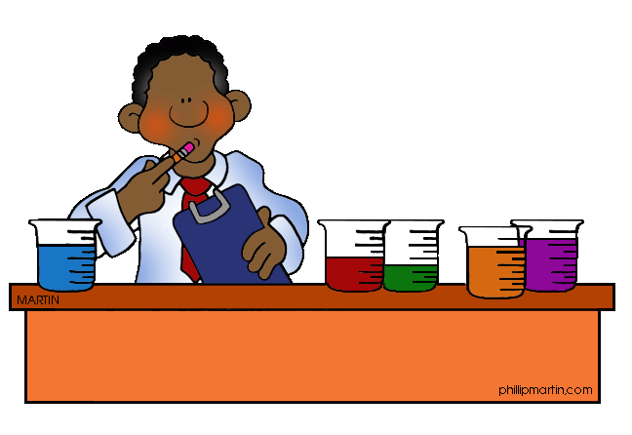
Scientific Investigation
No single scientific method
Important steps to any investigations:
Observe
Collect information
Test ideas
Make predictions
Share findings

Slide 3
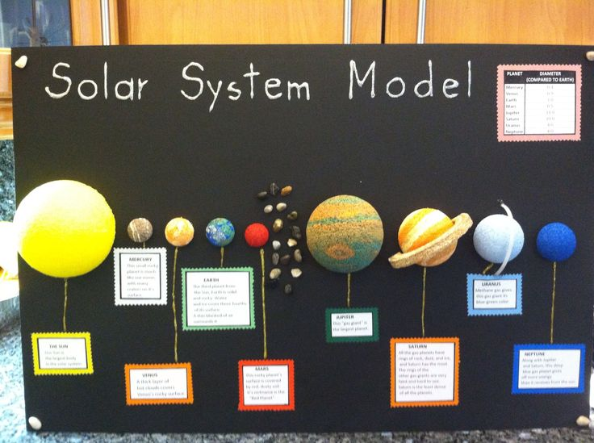
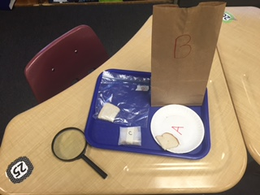
Scientific Investigation
Four Types of Investigations:
Models
Surveys
Sampling
Controlled Experiment

Slide 4
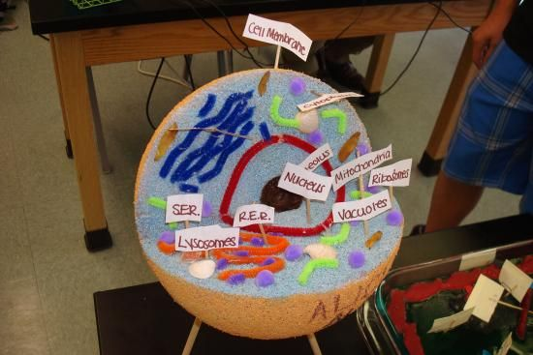
Models
Helpful tools
Used to study:
Large objects
Objects with many parts
Objects that are hard to see

Slide 5
Surveys and Sampling
Surveys
Sampling
Using questionnaires
Many people
Only a few people asked out of many

Slide 6
Review: Name four types of scientific investigations
Models
Surveys
Sampling
Experiments

Slide 7
Review: What is a model?
A model is an object or idea that represents another thing.
Scientists use models to study very large things, things with many parts, or things that are hard to see

Slide 8
Review: What tool do scientist use to conduct a survey?
A questionnaire

Slide 9
Review: How is using a survey different from using sampling?
In a survey, many people are questioned and examined in order to draw conclusions.
In sampling, only a few random people are examined in order to draw conclusions.

Slide 10
Controlled Experiment
1) Ask a question
2) Hypothesis
3) Identify and control variable
4) Make a plan
5) Test your hypothesis
6) Collect, record, and interpret your observations
7) State your conclusion
8) Do repeated trials

Slide 11
Identify and Control Variable
Independent Variable – The one thing you change
The method the bread was kept in (Baggie, Paper bag, Wax Paper)
Dependent Variable – The results you observe
The freshness of the bread at the end of our experiment
Controlled Variable – What you kept the same
Same piece of bread and same amount of time

Slide 12
Identify and Control Variable
Question | Independent Variable ( What I change) | Dependent Variable (What I observe) | Controlled Variables (What I keep the same)
How fast does a candle burn? | Time measured in minutes | Height of candle measured in centimeters at regular intervals of time (for example, every five minutes) | Use same type of candle for every test Wind—make sure there is none
How much water flows through a faucet at different openings? | Water faucet opening (closed, half open, fully open) | Amount of water flowing measured in liters per minute | The Faucet Water pressure, or how much the water is "pushing"

Slide 13
IMPORTANT!
Controlled Variables
Controlled Group
What you keep the same
The source of the bread
The time (4 days)
Temperature of the room
Standard which to measure
The bread on the paper plate

