Slide 1
Chapter 5 Lesson 3 Energy Transformations and Conservation
By the end of the lesson you will be able to answer:
How are different forms of energy related?
What is the Law of Conservation of Energy?

Slide 2
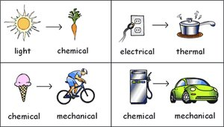
Energy Transformations
Change from 1 form of energy to another
Needed to do work
Single Transformations
Multiple Transformations
Example: Photosynthesis
http://www.science4us.com/elementary-physical-science/energy/energy-transformations/?unit=energy&demo=useyourclues

Slide 3
What energy transformations can happen when you are cold and you try to warm up?
Rubbing your hands together
Mechanical Energy ----→Thermal Energy
Jumping up and down
Mechanical Energy ----→ Thermal Energy
Using an electric blanket
Electrical Energy ----→ Thermal Energy
Standing in the sunlight
Nuclear Energy ----→ Electromagnetic Energy ----→ Thermal Energy

Slide 4
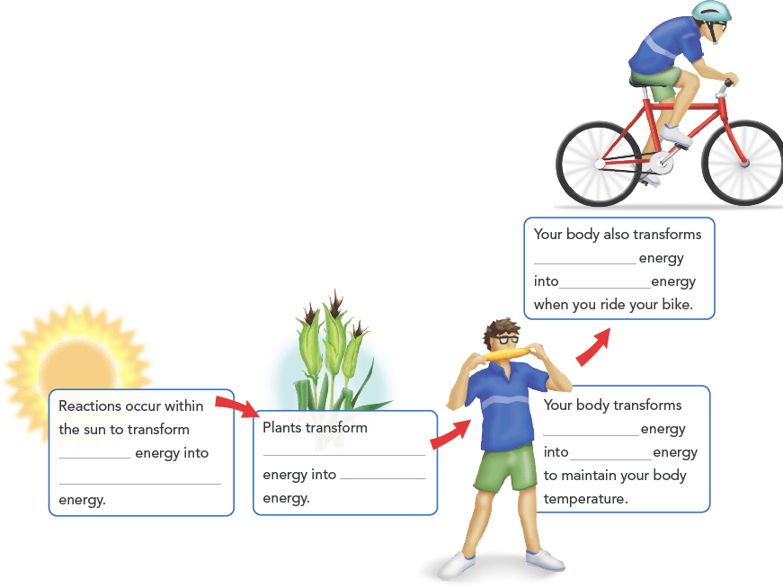
Multiple Transformations
A series of energy transformations must occur for you to ride your bike. What are the forms of energy involved in each transformation?
chemical
Mechanical
chemical
nuclear
electromagnetic
thermal
electromagnetic
chemical

Slide 5
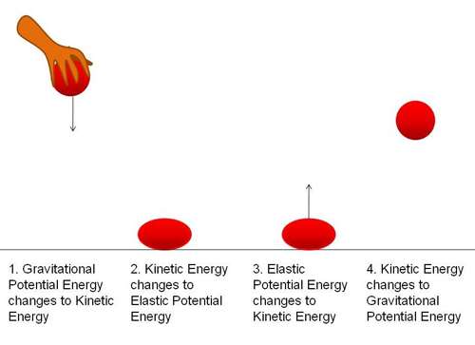
Kinetic & Potential Energy
1) When a ball is dropped, it possesses a certain amount of gravitational potential energy. As the ball falls, that energy is converted to kinetic energy.
2)When the ball collides with the floor, some of this kinetic energy is transferred to the floor and converted to thermal energy (friction) and elastic potential energy (ball deformation.) Some of the kinetic energy is also transferred to sound energy, in the ―boing noise we hear during the collision.
3)The remainder of the energy is used to bounce the ball back up but not as high as where it started because some of its energy has been transferred to the floor.

Slide 6
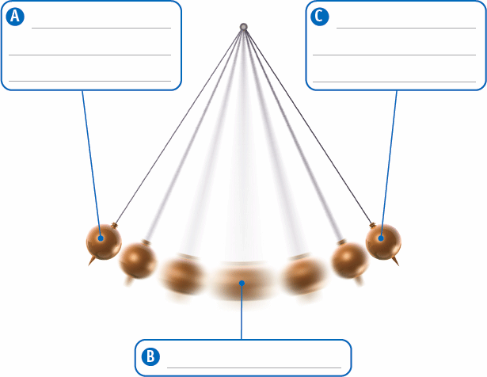
Kinetic & Potential Energy
Pendulum
A continuous transformation between potential and kinetic energy occurs in a pendulum. What are the types of energy the pendulum has at positions A, B, and C?

Slide 7
Heating up a frozen burrito

Slide 8
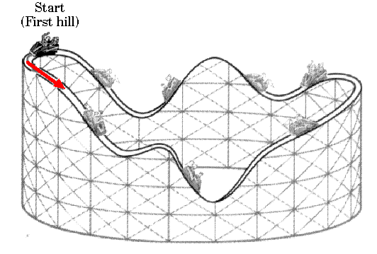
The Law of Conservation of Energy
Energy Before Transformation = Energy After Transformation
Energy is NEVER created or destroyed
It just changes forms
https://www.youtube.com/watch?v=btLU2lb3-xs

Slide 9
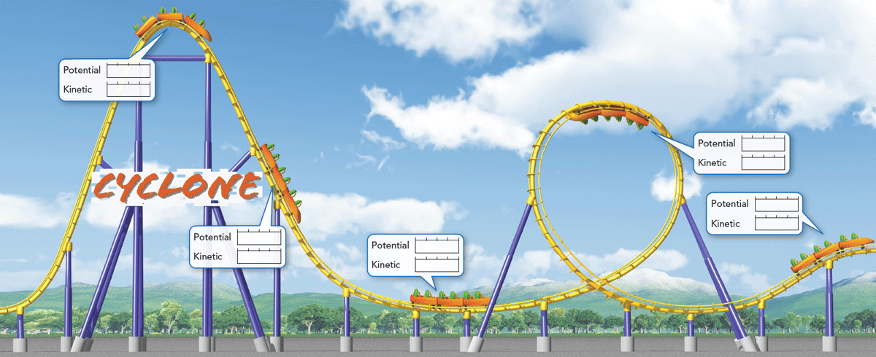
Energy Transformations and Conservation
Conserving Energy While You Ride
Transformations between potential and kinetic energy occur during a roller coaster ride. How much potential and kinetic energy does the coaster have at each point?

