Slide 1
Chapter 5 Lesson 1 What is Energy?
1)How are energy, work, and power related?
2) What are the two types of energy?

Slide 2
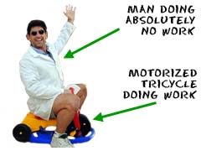
Work Work Work work & Energy!
Work is done when a force that is applied to an object moves that object
Transfer of energy
Measured in joules

Slide 3
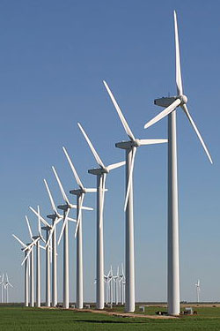
Power and Energy
Work is not affected by time
Power is the rate work is done
Power = work/time
Power is equal to energy transferred divided by time.
https://www.youtube.com/watch?v=btLU2lb3-xs

Slide 4
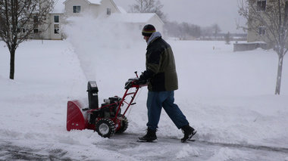
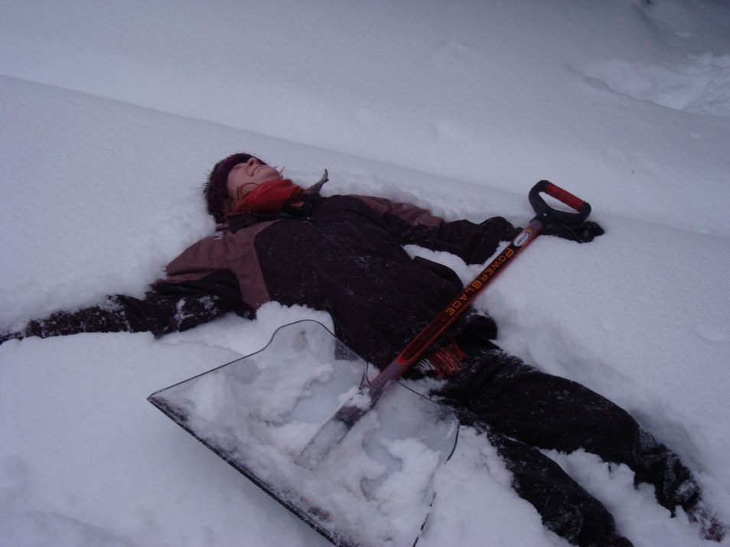
Same amount of Energy Different amounts of power
Less time
More time

Slide 5
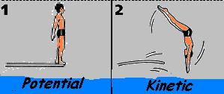
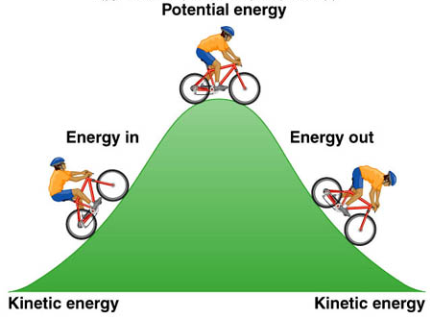
What are the Two Types of Energy?
Kinetic Energy and Potential Energy
Both are related to MOTION
Depends on
Motion
Position
Shape

Slide 6
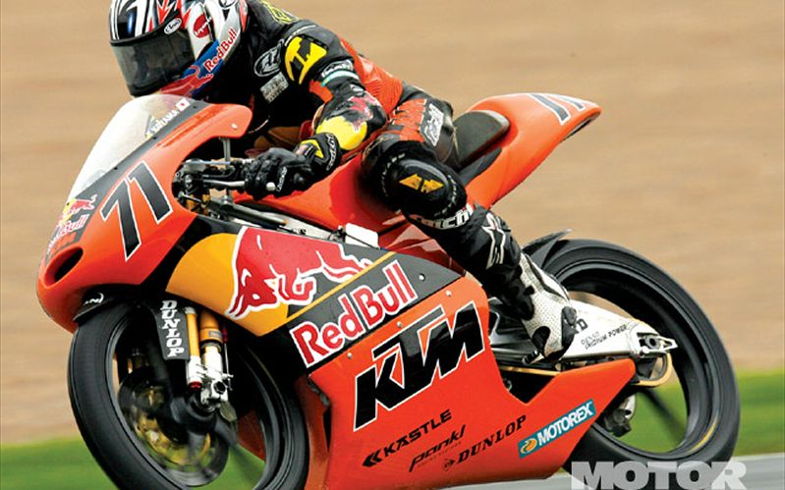
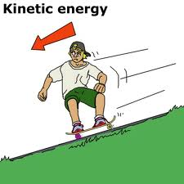
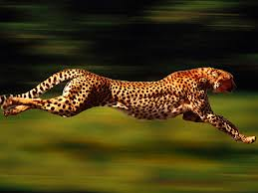
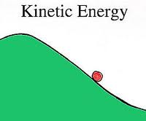
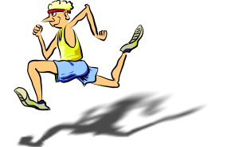
Kinetic Energy
ENERGY OF MOTION
Anytime you see something moving, you are seeing kinetic energy.
Moving bus
Roller coaster
Plane flying
Paratrooper jumping.
Nothing moves without energy

Slide 7
Kinetic Energy
Two things can affect the amount of kinetic energy of something.
Its mass…. Simply put, the bigger something is, the greater its energy.
Bigger Mass = More Energy
Its velocity(speed)…. Again, pretty simple. The faster it moves, the more energy it has.
More Speed = More Energy
http://www.brainpop.com/science/energy/kineticenergy/

Slide 8
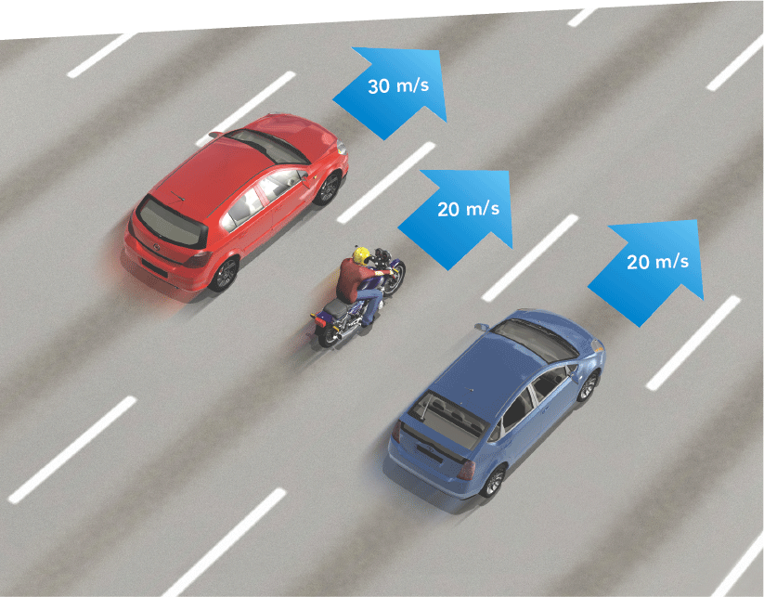
Kinetic Energy
List the vehicles in order of increasing kinetic energy
___________
___________
___________

Slide 9
Time for Math!
You serve a volleyball with a mass of 2.1 kg. The ball leaves your hand with a speed of 30 m/s.

Slide 10
Time for Math!
A girl and her dog are running. The dog has a mass of 20 kg. The girl has a mass of 60 kg. Both have a speed of 2 m/s.
Kinetic Energy of dog=
Kinetic Energy of girl=

Slide 11
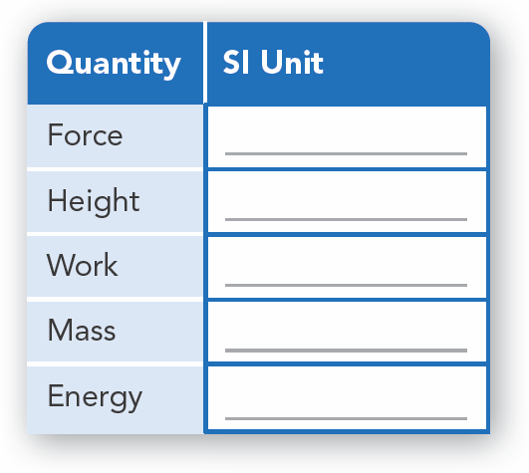
What is energy?

Slide 12
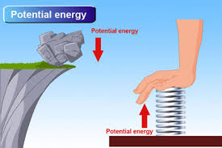
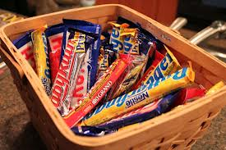
Potential Energy
Stored Energy
Things sitting up high have more potential energy than things sitting on the ground.
Potential energy turns into kinetic energy once it starts to move
http://www.brainpop.com/science/energy/potentialenergy/

Slide 13
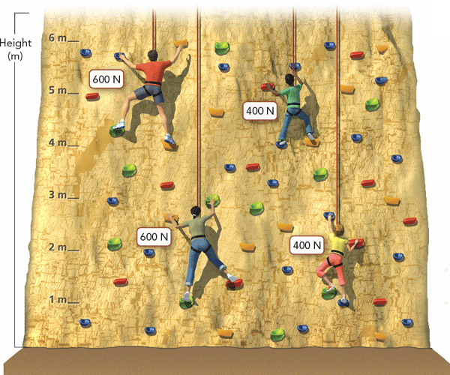
Potential Energy
Gravitational Potential Energy
The rock climbers have gravitational potential energy, which is potential energy related to an object's height.
Do the math!

Slide 14
Elastic Potential Energy
Elastic Potential Energy
The energy stored in a stretched object, such as the trampoline, is elastic potential energy. Using 1 as the greatest, how would you rank the amount of elastic potential energy of the trampoline from greatest to least?

