Slide 1
The Black Death
Objective
Explain the effects of the Black Death along with economic, environmental and social factors that led to the decline of medieval society

Slide 2
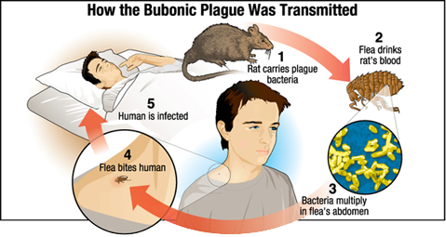

Slide 3
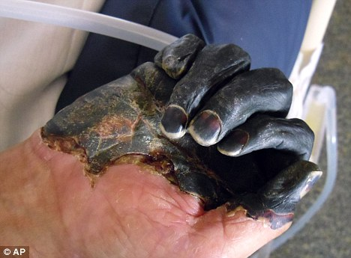
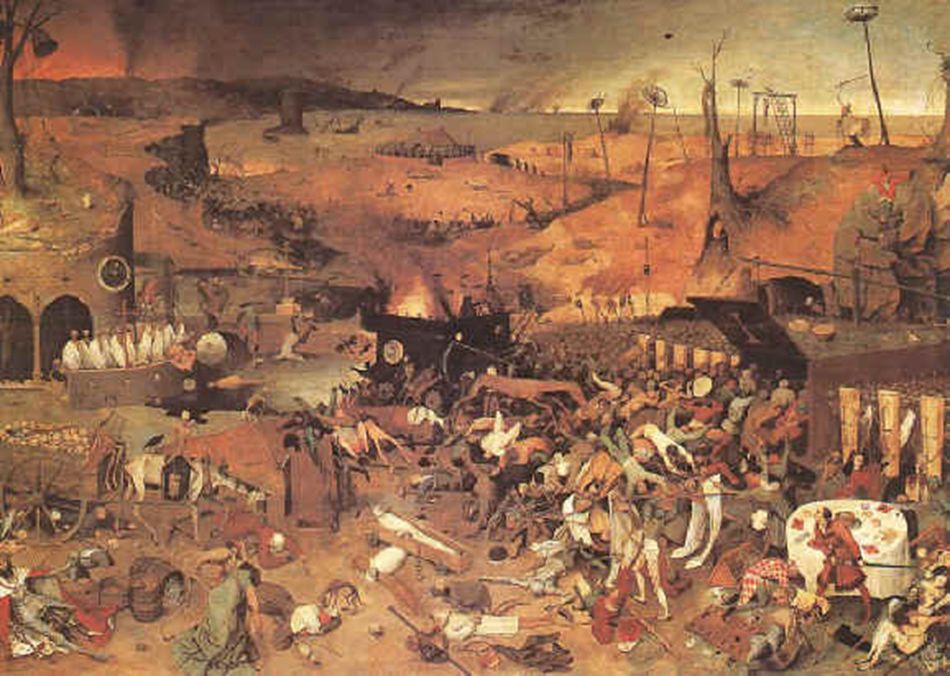
The Black Death
Caused by rats and fleas
Spread through trade routes
Infected people and animals

Slide 4
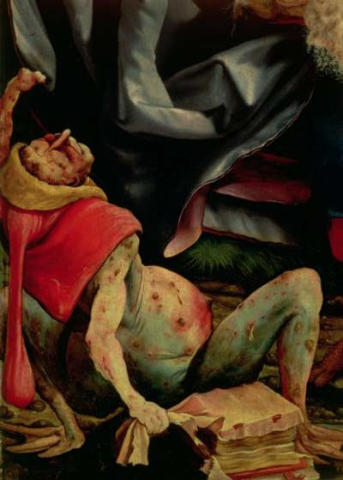
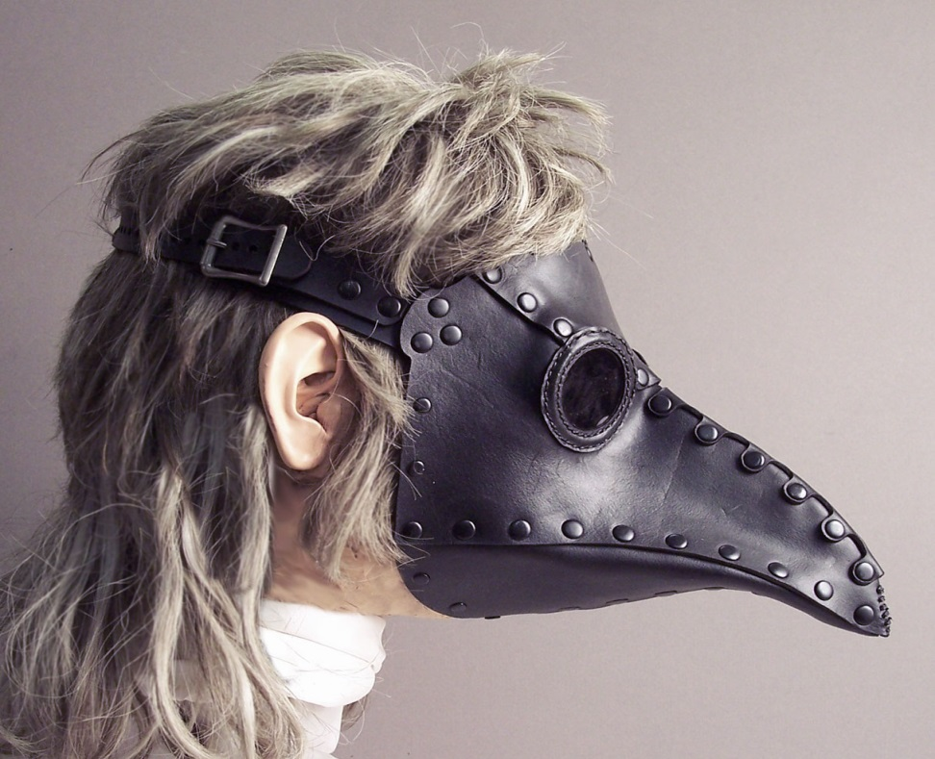
Treatment
NO ONE knew how disease was transmitted or how to treat it
Plague doctors tried bloodletting and boil-lancing
VERY DANGEROUS!
Didn’t help!

Slide 5
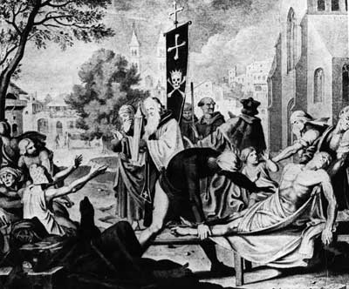
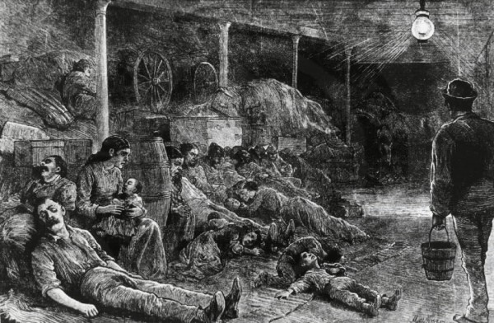
http://www.schoolhistory.co.uk/games/fling/plague/index.shtml

Slide 6
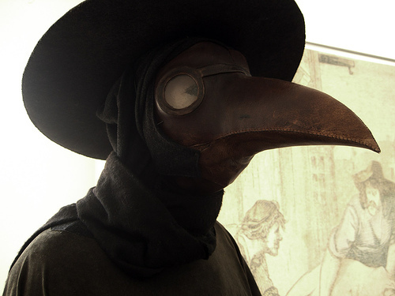
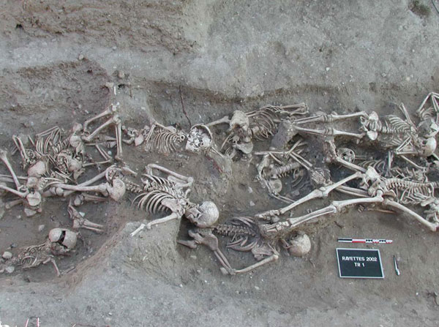
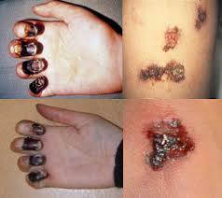

Slide 7
