Slide 1
The Sky from earth Chapter 6 Lesson 1
Objectives
1) Identify objects and constellations visible without a telescope in the night sky.
2) Describe the apparent motions of stars and planets throughout the year.

Slide 2
The Universe
There are at least 100 billion galaxies in our universe. Some believe there are up to 500 billion
100,000,000,000
Our solar system is located in one of those galaxies
Does anyone know the name of our galaxy?

Slide 3
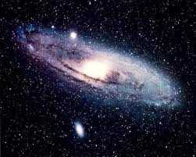
The Milky Way, our home galaxy
You live in the Milky Way Galaxy!
There are over 100 billion planets in this one galaxy
Spiral Shape

Slide 4
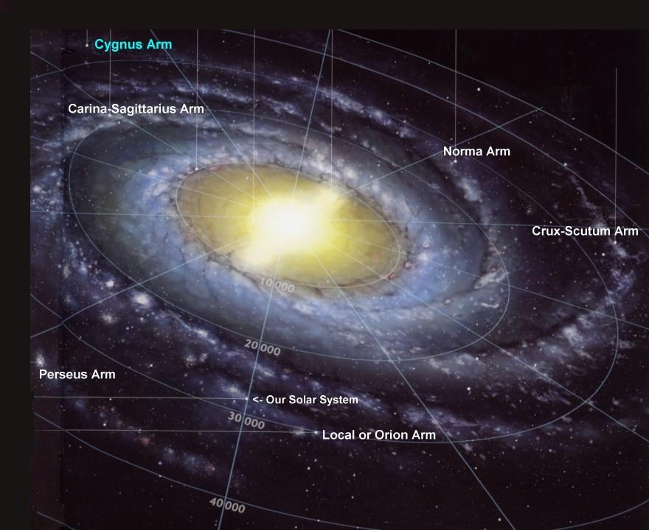

Slide 5
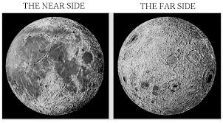
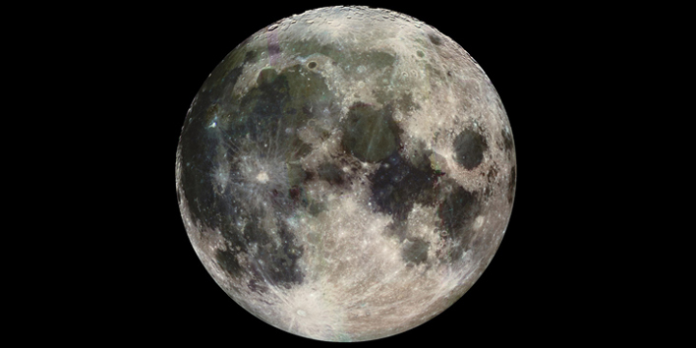
Moon
If an object revolves around a planet, it is a moon
If it revolves around a star, it is a planet

Slide 6
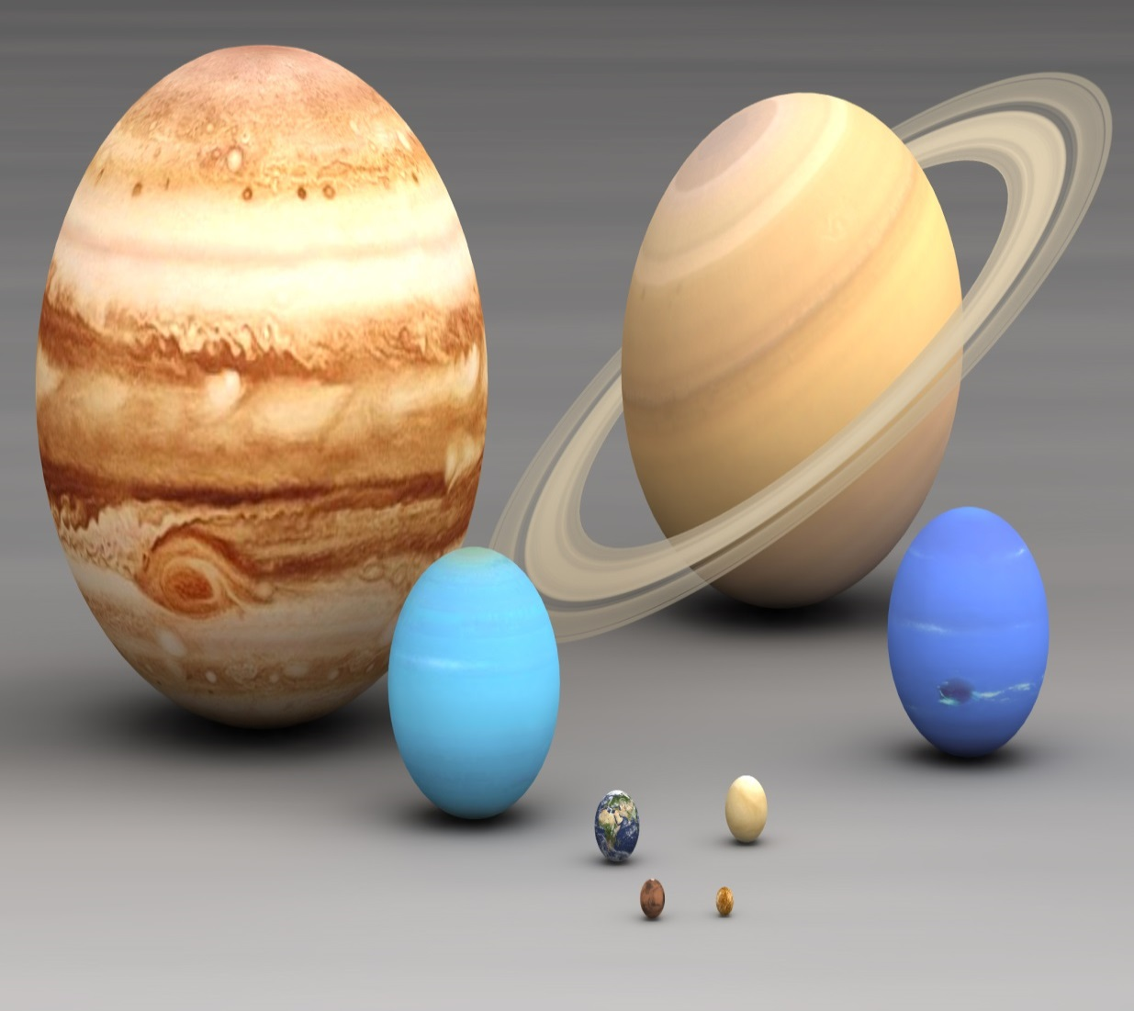
planets
In orbit around the Sun
Has sufficient mass to assume a nearly round shape
Is not a satellite
Has cleared the neighborhood around its orbit

Slide 7
Planets What happened to pluto?
What Is a Planet Today?
According to the new definition, a full-fledged planet is an object that orbits the sun and is large enough to have become round due to the force of its own gravity. In addition, a planet has to dominate the neighborhood around its orbit.
Pluto has been demoted because it does not dominate its neighborhood. Charon, its large "moon," is only about half the size of Pluto and orbits along with it, while all the true planets are far larger than their moons.

Slide 8
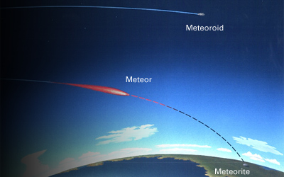
Meteors
Meteoroids become meteors -- or shooting stars -- when they interact with a planet's atmosphere and cause a streak of light in the sky.
Debris that makes it to the surface of a planet from meteoroids are called meteorites.
Meteorites may vary in size from tiny grains to large boulders. .

Slide 9
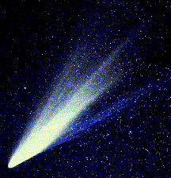
comets
Frozen Mass of Rock, Dust, and Ice
Long Orbits around the sun
Have tails

Slide 10
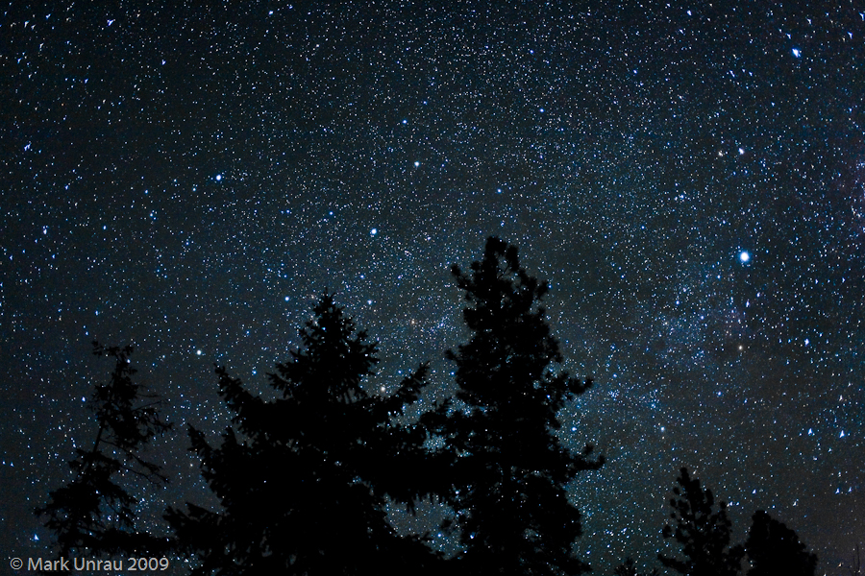
Stars
Our Sun is a medium sized star
Made of hydrogen and helium
Explode when they die
Super nova
http://science.nasa.gov/astrophysics/focus-areas/how-do-stars-form-and-evolve/

Slide 11
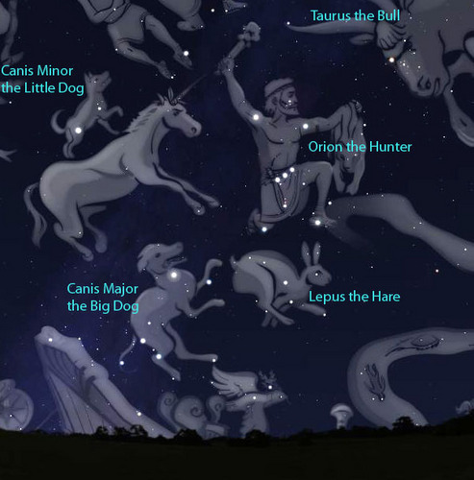
Constellations
Most names come from Greek myths
Use a star chart
Seems to move as seasons change
Caused by Earth revolving around the sun, so we have a different view of the stars.
http://www.pearsonsuccessnet.com/snpapp/learn/navigateIDP.do?method=vlo&internalId=140611115000080&isHtml5Sco=false#
http://www.kidsastronomy.com/astroskymap/constellation_hunt.htm

Slide 12
Finding Constellations
What are the names of the constellations in this figure?
http://www.pearsonsuccessnet.com/snpapp/learn/navigateIDP.do?method=vlo&internalId=140611115000080&isHtml5Sco=false#

Slide 13
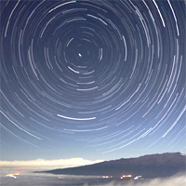
Do Stars move?
Not really. They just appear to move in the sky
Earth spins on its axis
Making the star appear to move from east to west
http://www.slate.com/blogs/bad_astronomy/2014/01/25/time_lapse_video_ancients.html

Slide 14
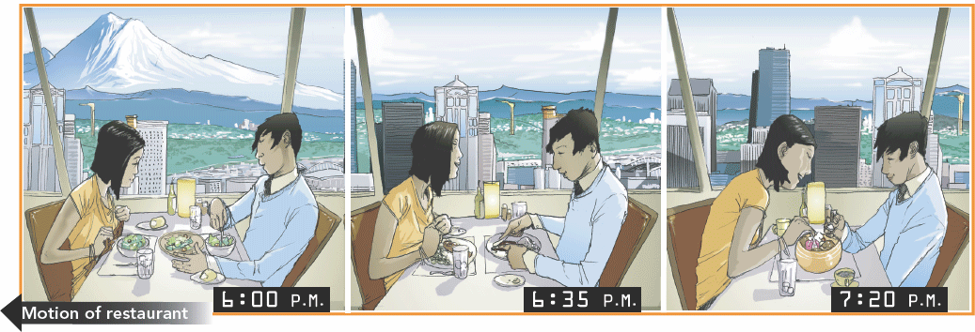
Opposite Motions
Where would the mountain appear at each time shown?

